Slide 1
Digital Electronics & Logic Design

Slide 2
Topics to be covered:
Asynchronous (ripple) counter
Ring counter
Johnson counter
Shift registers

Slide 3
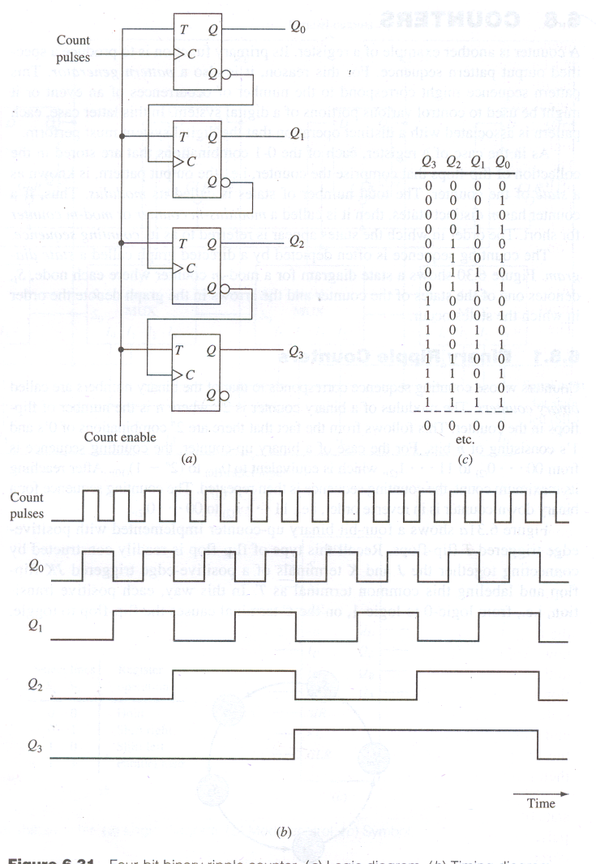
4-bit Binary Ripple Counter :
All Flip-Flops are in toggle mode.
The clock input is applied.
Count enable = 1.
Counter counts from 0000 to 1111.

Slide 4
Divide-by-2, 4, 8 Counters (asynchronous)
Use a toggle flip-flop (J-K connected together)
· the output of the flip-flop “toggles” at every clock pulse
Divide-by-2 counter
NOTE : negative clock pulsed clock
The circuit divides the clock frequency by 2.

Slide 5
Divide-by-2, 4, 8 Counters (asynchronous)
Divide-by-2, 4, 8 counters can also be designed,
⇒ circuit divides the clock frequency by 2, 4 or 8
Divide-by-n Counters are asynchronous
No common synchronising clock input is applied to all the flip-flops.
Clock is actually used for data in these applications.

Slide 6
Divide-by-2,4,8 Counter (asynchronous)
Synchronous Counters are distinguished from ripple counters in that clock pulses are applied to the clock inputs of all the flip-flops.
common pulse triggers all flip-flops simultaneously rather than one at a time in succession (as in ripple counter)

Slide 7
Difference between Asynchronous and Synchronous Counter :
Asynchronous Counter | Synchronous Counter
1. Clock input is applied to LSB FF. The output of first FF is connected as clock to next FF. | 1. Clock input is common to all FF.
2. All Flip-Flops are toggle FF. | 2. Any FF can be used.
3. Speed depends on no. of FF used for n bit . | 3. Speed is independent of no. of FF used.
4. No extra Logic Gates are required. Cost is less. | 4. Logic Gates are required based on design. Cost is more.
1
f_{max} =
n x t_{p}
1
f_{max} =
t_{p}

Slide 8
Example Problem
ECEn 224
13 COUNTERS
Page 8
Design a 3-bit binary counter
The Z output is TRUE iff count value is even
The Y output is TRUE iff count value is multiple of 3

Slide 9
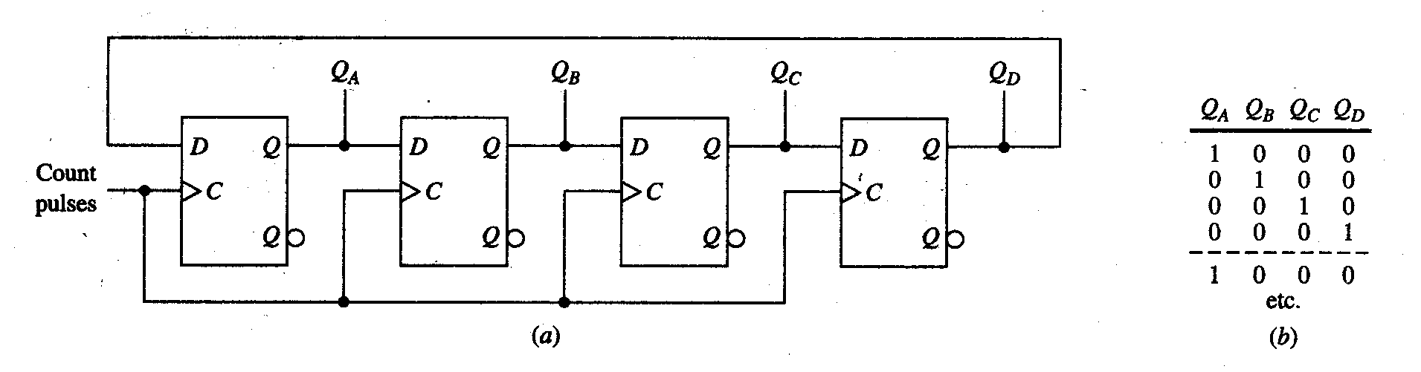
Counters Based on Shift Register
Mod-4 Ring Counter
The output of LSB FF is connected as D input to MSB FF.
This is commonly called as Ring Counter or Circular Counter.
The data is shifted to right with each clock pulse.
This counter has four different states.
This can be extended to any no. of bits.

Slide 10
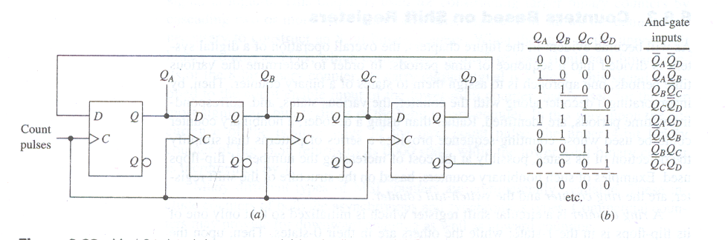
Twisted Ring Counter or Johnson Counter
Mod-8 Johnson Counter
The complement output of LSB FF is connected as D input to MSB FF.
This is commonly called as Johnson Counter.
The data is shifted to right with each clock pulse.
This counter has eight different states.
This can be extended to any no. of bits.

Slide 11
Shift Registers
Using registers to store, manipulate and transfer data
11

Slide 12
Definition
12
A register is a digital circuit with two basic functions: Data Storage and Data Movement
A shift register provides the data movement function
A shift register “shifts” its output once every clock cycle
A shift register is a group of flip-flops set up in a linear fashion with their inputs and outputs connected together in such a way that the data is shifted from one device to another when the circuit is active

Slide 13
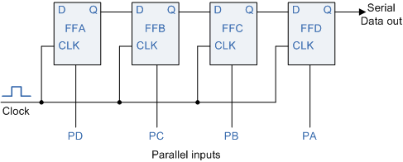
Shift Register Applications
some counter applications
Johnson counter
ring counter
time delay devices
Communications:
converting between serial data and parallel data.
temporary storage in a processor.
some arithmetic operations-
multiply, divide
13

Slide 14
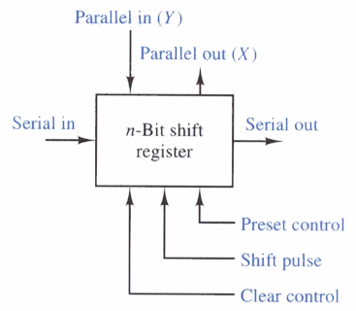
Shift Register Characteristics
Types
Serial-in, Serial-out
Serial-in, Parallel-out
Parallel-in, Serial-out
Parallel-in, Parallel-out
Universal
Direction
Left shift
Right shift
Rotate (right or left)
Bidirectional
n-bit shift register
14

Slide 15
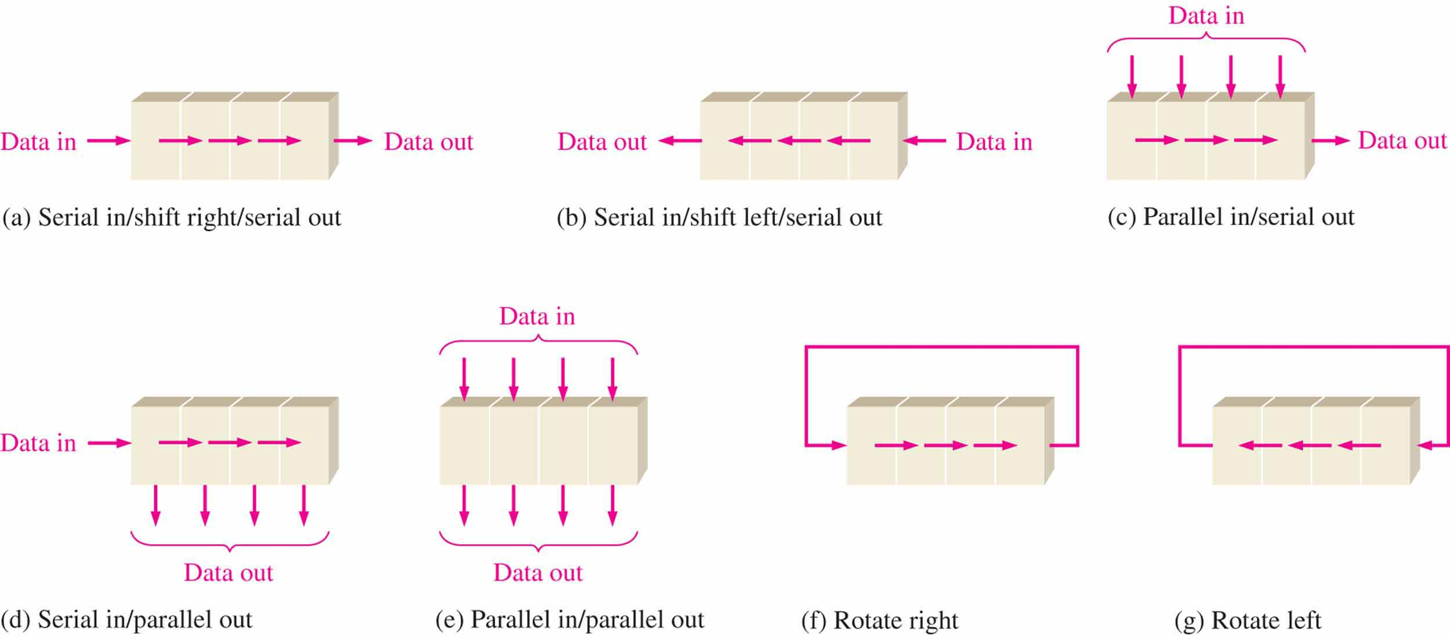
Data Movement
The bits in a shift register can move in any of the following manners
15

Slide 16
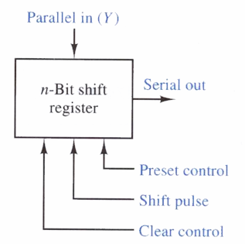
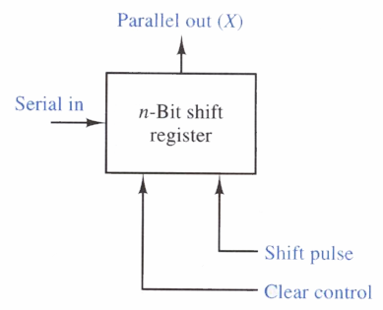
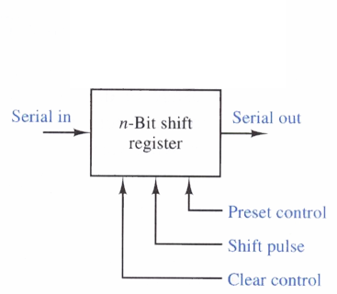
Data Movement
n-bit shift register
n-bit shift register
n-bit shift register
n-bit shift register
16

Slide 17
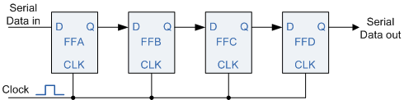
Serial-In Serial-Out
Data bits come in one at a time and leave one at a time
One Flip-Flop for each bit to be handled
Movement can be left or right, but is usually only a single direction in a given register
Asynchronous preset and clear inputs are used to set initial values
n-bit shift register
17

Slide 18
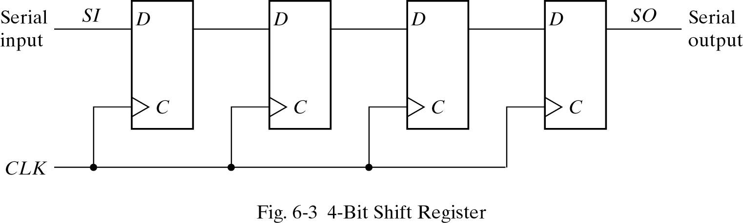
Shift Registers
The simplest shift register is one that uses only Flip-Flops
The output of a given Flip-Flop is connected to the D input of the Flip-Flop at its right.
Each clock pulse shifts the contents of the register one bit position to the right.
The Serial input (SI) determines what goes into the leftmost Flip-Flop during the shift. The Serial output (SO) is taken from the output of the rightmost Flip-Flop.
Q
Q
Q
Q
18

Slide 19
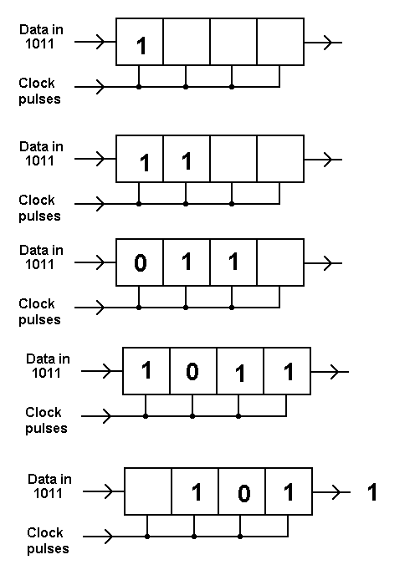
Serial-In Serial-Out
A simple way of looking at the serial shifting operation, with a focus on the data bits, is illustrated at right
The 4-bit data word “1011” is to be shifted into a 4-bit shift register
One shift per clock pulse
Data is shown entering at left and shifting right
1
2
3
4
5
19

Slide 20
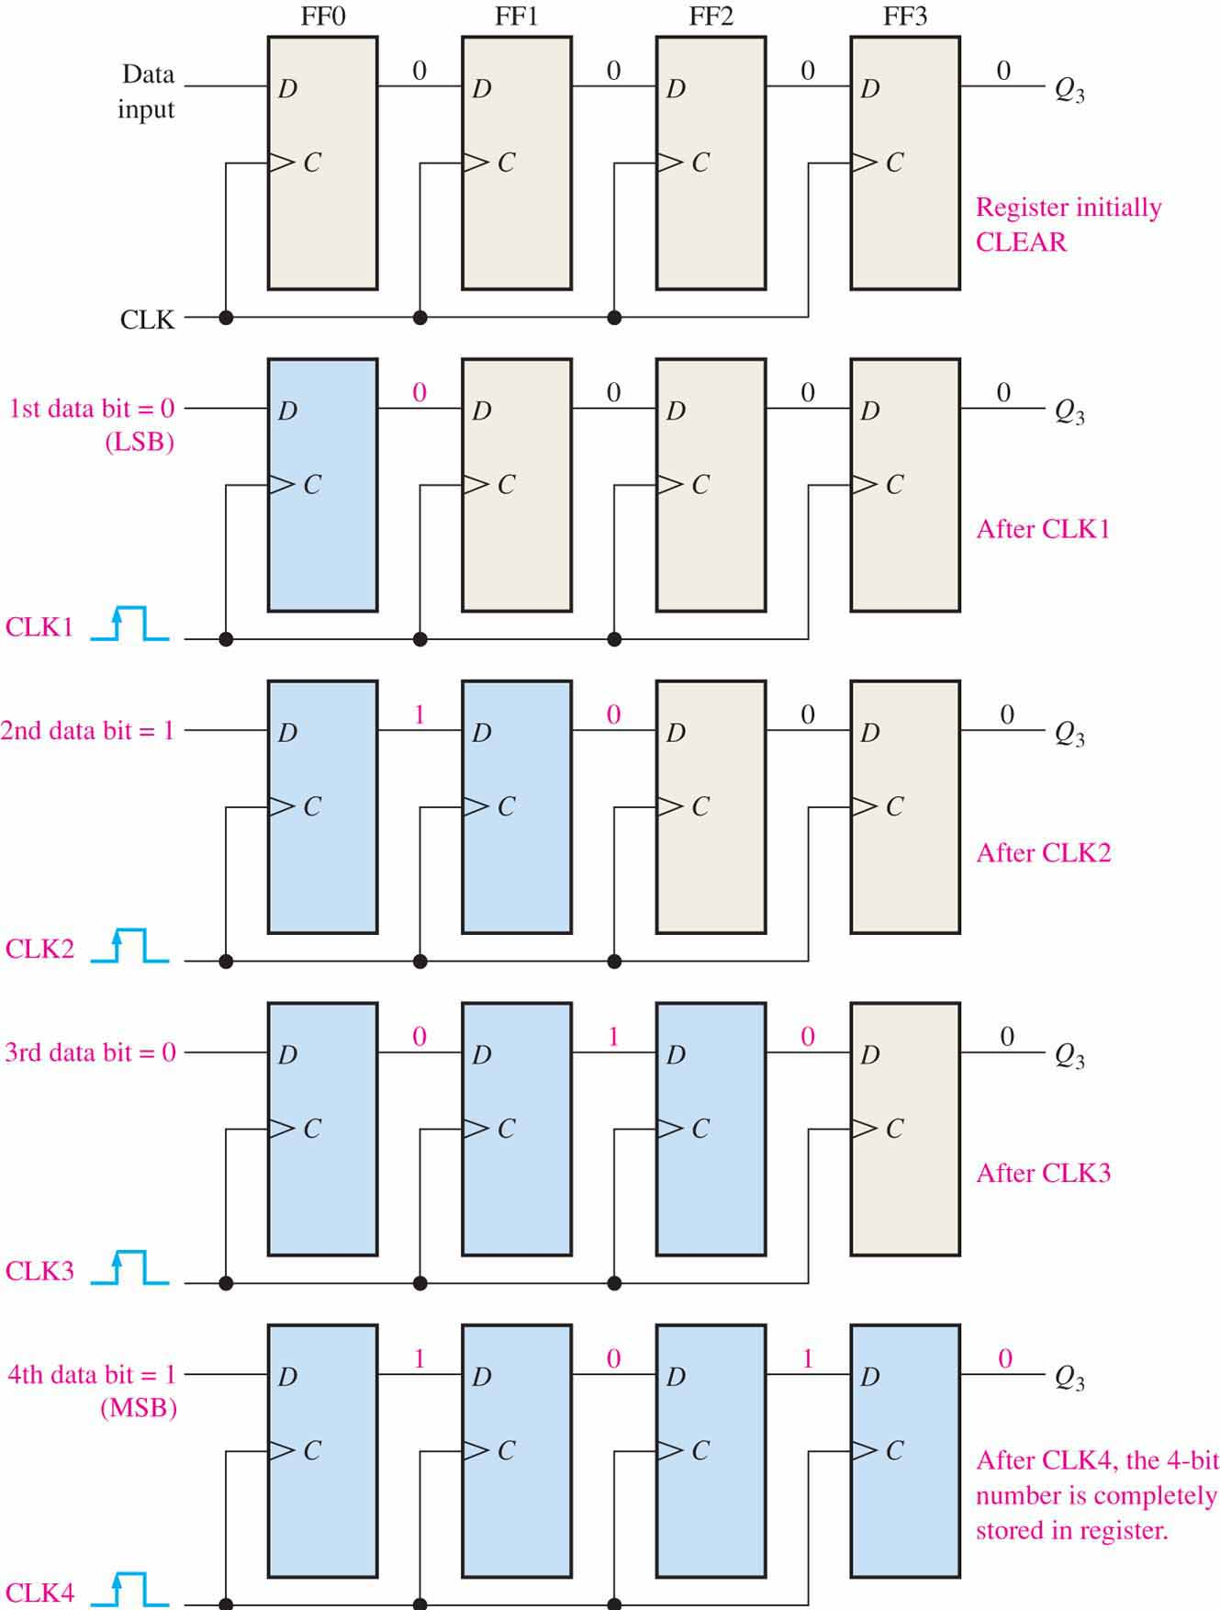
Serial-In Serial-Out
The diagram at right shows the 4-bit sequence “1010” being loaded into the 4-bit serial-in serial-out shift register
Each bit moves one position to the right each time the clock’s leading edge occurs
Four clock pulses loads the register
20

Slide 21
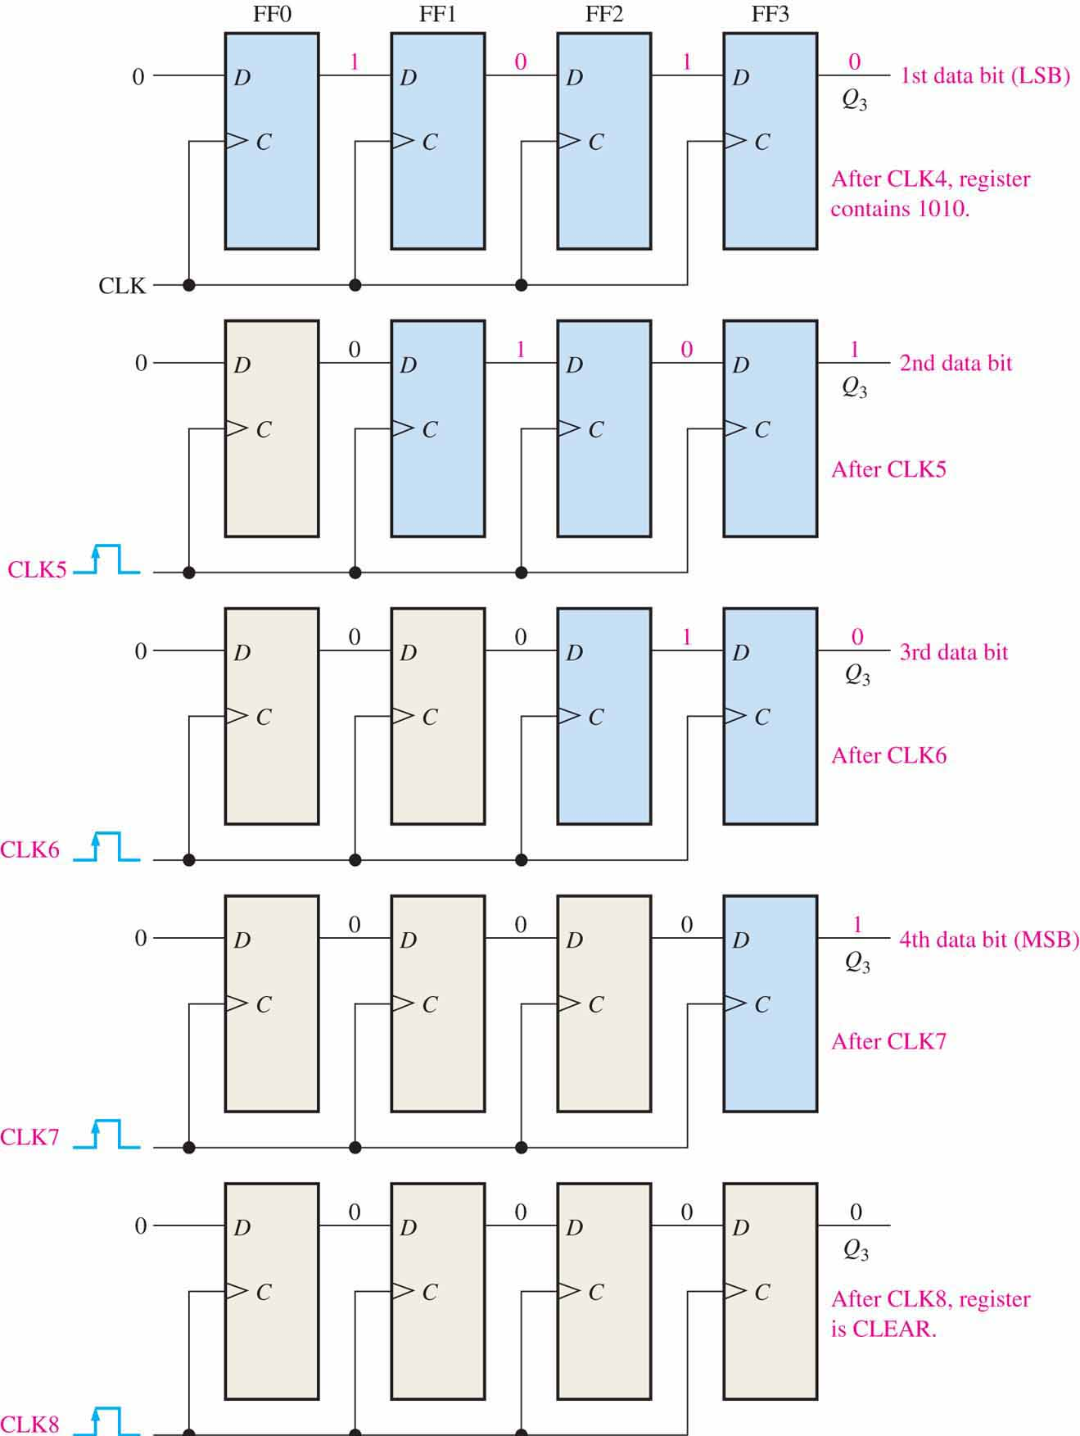
Serial-In Serial-Out
This diagram shows the 4-bit sequence “1010” as it is unloaded from the 4-bit serial-in serial-out shift register
Each bit moves one position to the right each time the clock’s leading edge occurs
Four clock pulses unloads the register
21

Slide 22
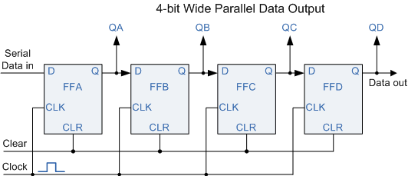
Serial-to-Parallel Conversion
We often need to convert from serial to parallel
e.g., after receiving a series transmission
The diagrams at right illustrate a 4-bit serial-in parallel-out shift register
Note that we could also use the Q of the right-most Flip-Flop as a serial-out output
n-bit shift register
22

Slide 23
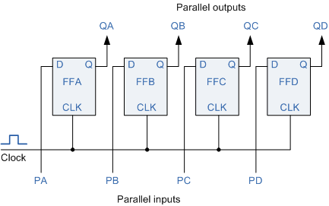
Serial-to-Parallel Conversion
These two shift registers are used to convert serial data to parallel data
The upper shift register would “grab” the data once it was shifted into the lower register
23

Slide 24
Parallel-to-Serial Conversion
We usa a Parallel-in Serial-out Shift Register
The DATA is applied in parallel form to the parallel input pins PA to PD of the register
It is then read out sequentially from the register one bit at a time from PA to PD on each clock cycle in a serial format
One clock pulse to load
Four pulses to unload
n-bit shift register
24

Slide 25
Parallel-In Parallel-Out
Parallel-in Parallel-out Shift Registers can serve as a temporary storage device or as a time delay device.
The DATA is presented in a parallel format to the parallel input pins PA to PD and then shifted to the corresponding output pins QA to QD when the registers are clocked.
One clock pulse to load
One pulse to unload
25

Slide 26
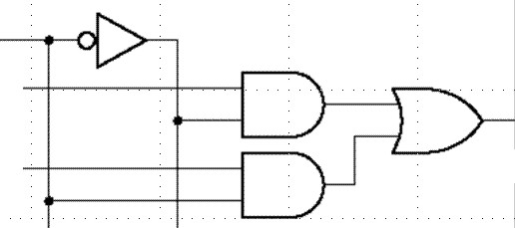
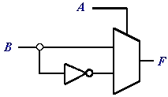
Universal Shift Register
Universal shift register
Can do any combination of parallel and serial input/output operations
Requires additional inputs to specify desired function
Uses a Mux-like input gating
n-bit shift register
L/S
L/S
A
0
0
F
A
B
1
B
1
26

Slide 27
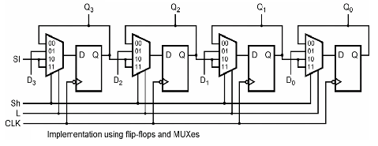
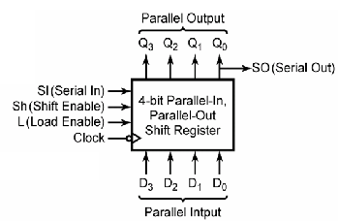
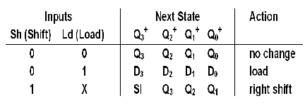
Universal Shift Register
Parallel shift register (can serve as converting parallel-in to serial-out shifter):
27

